Slide 1
Hamiltonian on the basis of j j_{z} states
But eigen-states for small fields are the j j_{z} states
Basis transformation

Slide 2









Hamiltonian on the basis of j j_{z} states

Slide 3






Hamiltonian on the basis of j j_{z} states

Slide 4
Hamiltonian on the basis of j j_{z} states

Slide 5
Hamiltonian on the basis of j j_{z} states

Slide 6
Magnetic fields – with spin-orbit coupling : p-shell
Eigen-values as a function of magnetic field strength

Slide 7
Magnetic fields – with spin-orbit coupling : p-shell
Eigen-values as a function of magnetic field strength

Slide 8
Effective model for the lowest doublet – g-tensor
Eigen-values as a function of magnetic field strength

Slide 9
Effective model for the lowest doublet – g-tensor
Eigen-values as a function of magnetic field strength

Slide 10
Magnetic fields – with spin-orbit coupling : p-shell
Eigen-values as a function of magnetic field strength

Slide 11
Magnetic fields – with spin-orbit coupling : p-shell
Eigen-values as a function of magnetic field strength

Slide 12
Temperature and magnetic susceptibility
Eigen-values as a function of magnetic field strength

Slide 13
Temperature and magnetic susceptibility
ξ=2 meV
B=10 T
Occupation and moments at finite temperature according to Bolzmann statistics

Slide 14
Temperature and magnetic susceptibility
ξ=2 meV
B=10 T

Slide 15
Temperature and magnetic susceptibility
ξ=2 meV
B=10 T

Slide 16
Temperature and magnetic susceptibility
ξ=2 meV
B=10 T

Slide 17
Temperature and magnetic susceptibility
ξ=2 meV
B=10 T

Slide 18
Temperature and magnetic susceptibility
ξ=2 meV
B=10 T
Curie/Weiss temperature, not related to magnetic ordering, but to low lying magnetic states

Slide 19
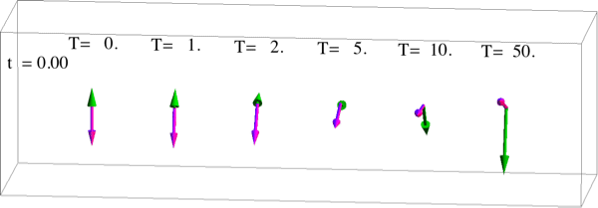
Temperature fluctuations
ξ=2 meV
B=10 T
s l

Slide 20
Spin-orbit coupling and (one electron) crystal-fields
From atoms to solids part (1)
Approximate the solid by a single atom.
(works only for local properties and for insulators)
(d-d transitions, magnetic anisotropy, …)
Model the effect of the crystal by an effective potential.
Those potentials are not real, they mimic covalent bonding
It has the symmetries right and finds the right multiplicities for local states. Although simple good for some properties on some matterials

Slide 21
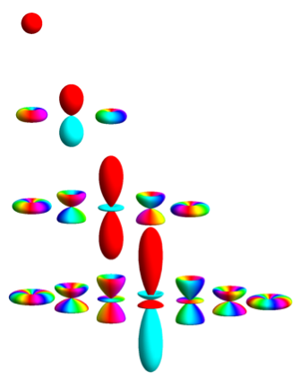
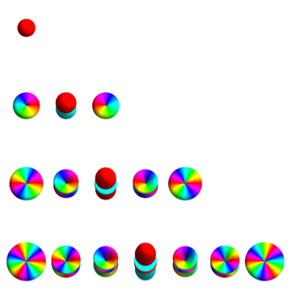
Atomic orbitals – Spherical Harmonics

Slide 22
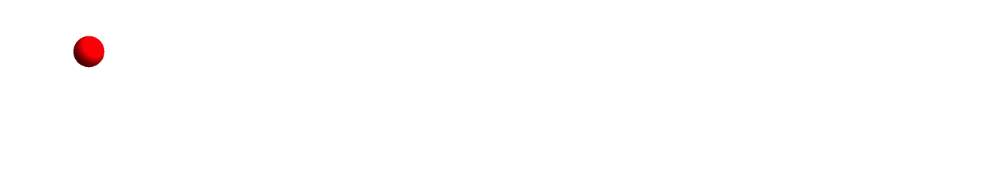
In solids orbitals turn real – linear combination of Y_{lm}
real s-orbitals (Kubic Harmonics)

Slide 23
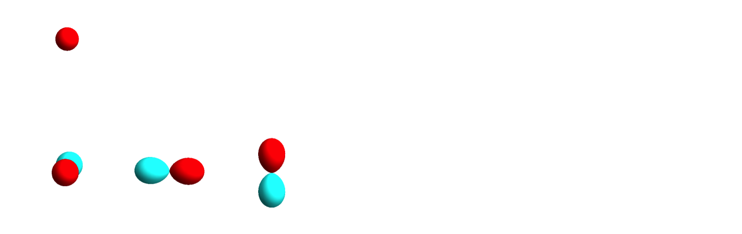
In solids orbitals turn real – linear combination of Y_{lm}
Real p-orbitals (Kubic Harmonics)

Slide 24
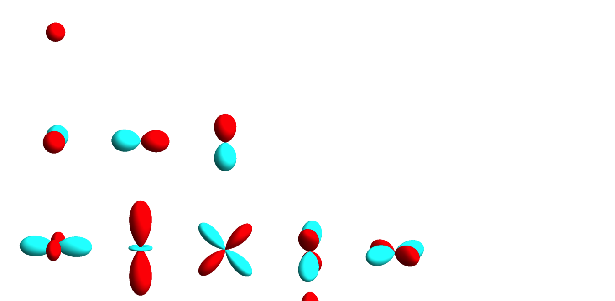
In solids orbitals turn real – linear combination of Y_{lm}
Real d-orbitals (Kubic Harmonics)

Slide 25
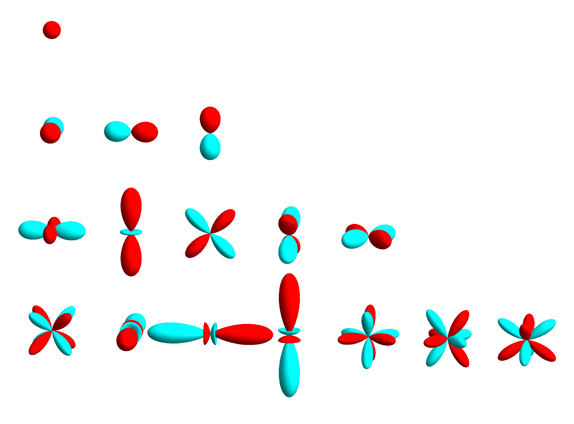
In solids orbitals turn real – linear combination of Y_{lm}
Real f-orbitals (Kubic Harmonics)

Slide 26
In solids orbitals turn real – linear combination of Y_{lm}
Names of groups of orbitals related to the irreducible representation (symmetry) of the orbital

Slide 27

Relation between complex and real orbitals
Example of p_{x} orbital

Slide 28
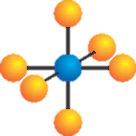
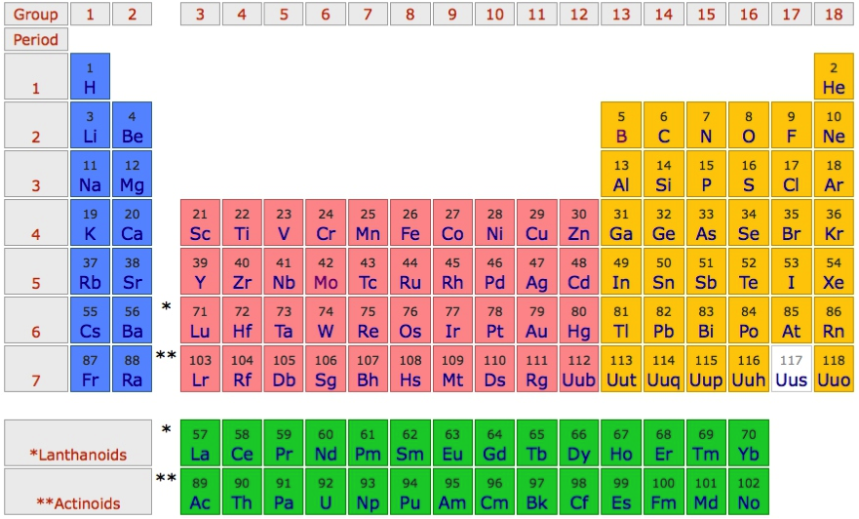
Crystal-field theory – example on NiO
O²⁻ - 2p⁶
Ni²⁺ - 4s⁰ 3d⁸

Slide 29
Crystal-field theory – example on NiO

Slide 30
Crystal-field theory – example on NiO
e_{g} orbitals have lobes that point towards the neighbor O atoms

Slide 31
Crystal-field theory – example on NiO
t_{2g} orbitals have lobes that point
in-between the neighbor O atoms

Slide 32
Crystal-field theory – example on NiO
Crystal-field theory models the energy difference between the
t_{2g} and e_{g} orbitals

Slide 33
Orbital energy level diagram obtained from LDA

Slide 34
Orbital energy level diagram obtained from LDA

Slide 35
Orbital energy level diagram obtained from LDA

Slide 36
Orbital energy level diagram obtained from LDA

Slide 37
Orbital energy level diagram obtained from LDA

Slide 38
Create ligand orbitals from O-2p Wannier orbitals

Slide 39
Create ligand orbitals from O-2p Wannier orbitals

Slide 40
Create ligand orbitals from O-2p Wannier orbitals

Slide 41
Create ligand orbitals from O-2p Wannier orbitals

Slide 42
Create ligand orbitals from O-2p Wannier orbitals

Slide 43
Create ligand orbitals from O-2p Wannier orbitals

Slide 44
Create ligand orbitals from O-2p Wannier orbitals

Slide 45
Create ligand orbitals from O-2p Wannier orbitals

Slide 46
Create ligand orbitals from O-2p Wannier orbitals

Slide 47
Create ligand orbitals from O-2p Wannier orbitals

Slide 48
Create ligand orbitals from O-2p Wannier orbitals

Slide 49
Create ligand orbitals from O-2p Wannier orbitals

Slide 50
Create ligand orbitals from O-2p Wannier orbitals

Slide 51
Create ligand orbitals from O-2p Wannier orbitals

Slide 52
Orbital energy level diagram obtained from LDA

Slide 53
Orbital energy level diagram obtained from LDA

Slide 54
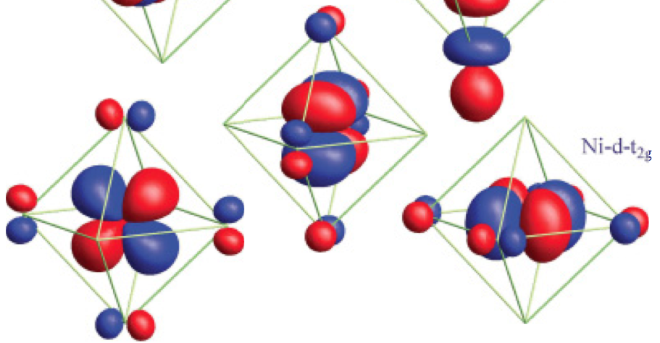
Orbital energy level diagram obtained from LDA
In crystal field theory we approximate these (π*) orbitals as atomic Ni-t_{2g} orbitals with an effective potential

Slide 55
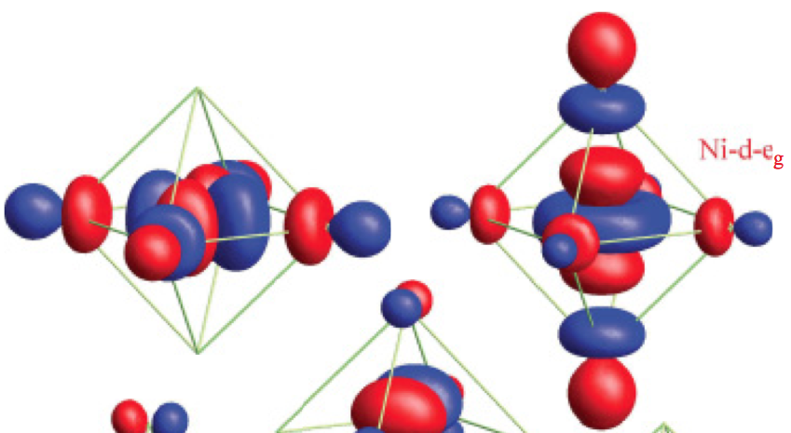
Orbital energy level diagram obtained from LDA
In crystal field theory we approximate these (σ*) orbitals as atomic Ni-e_{g} orbitals with an effective potential

Slide 56
Crystal-field theory – example on NiO
e_{g}
t_{2g}

Slide 57
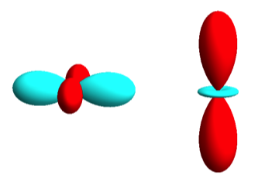
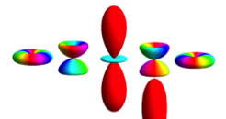
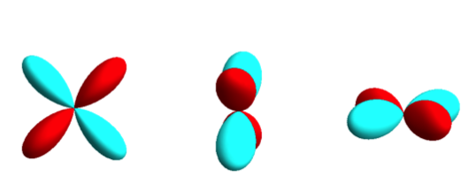
Energy level diagram – Oh symmetry (one d electron)
Energy level diagram: eigen-state energies as a function of crystal-field strength

Slide 58
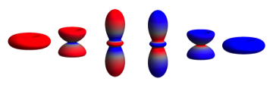

Energy level diagram – Oh’ symmetry (one d electron)
For the e_{g} orbitals the angular momentum is quenched. For the t_{2g} orbitals there is a rest angular momentum.
Energy level diagram: eigen-state energies as a function of crystal-field strength

Slide 59
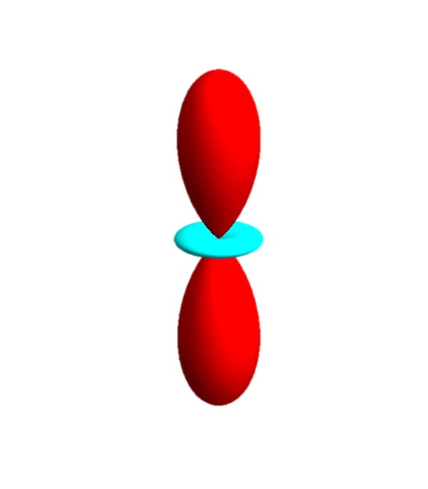
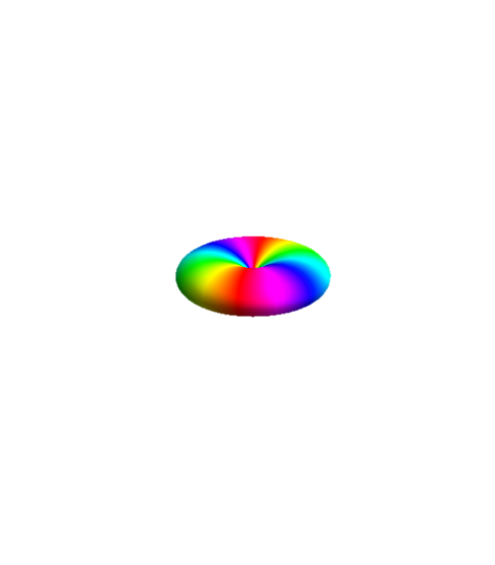
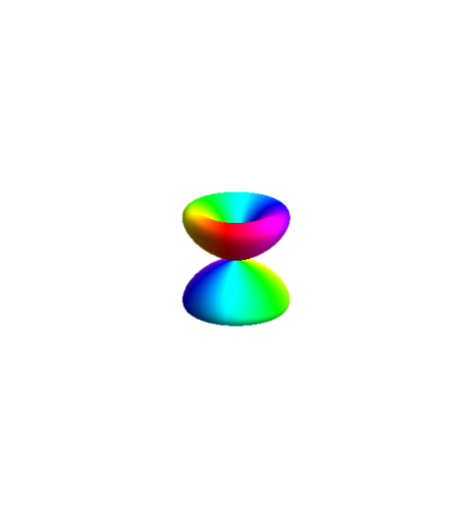
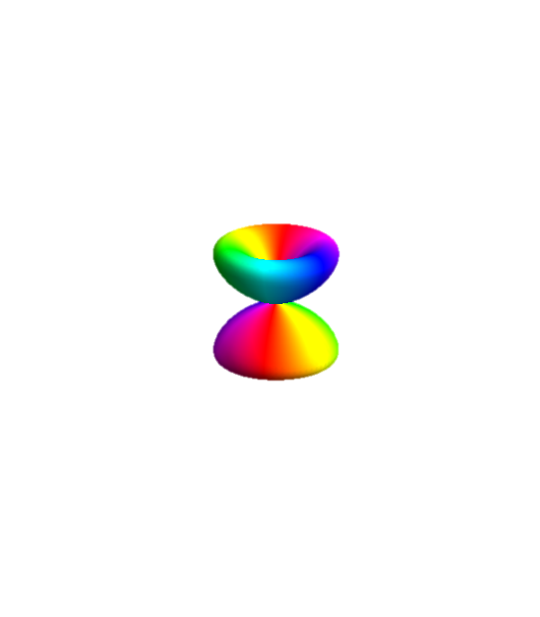
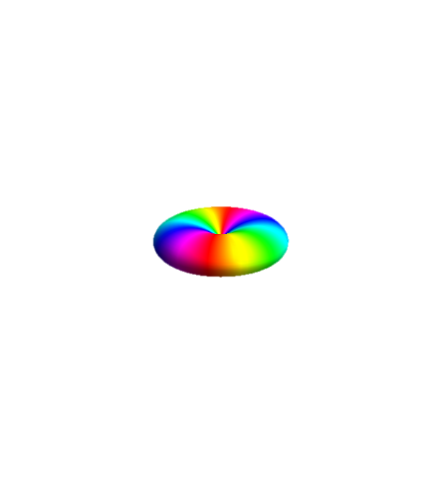
Atomic orbitals – angular momentum

Slide 60
Coupling to the lattice – quenching of angular momentum

Slide 61
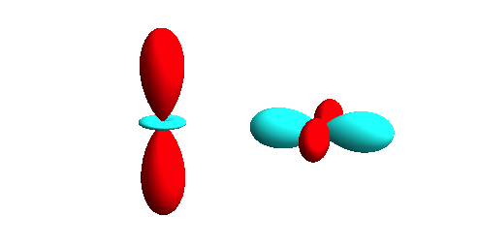
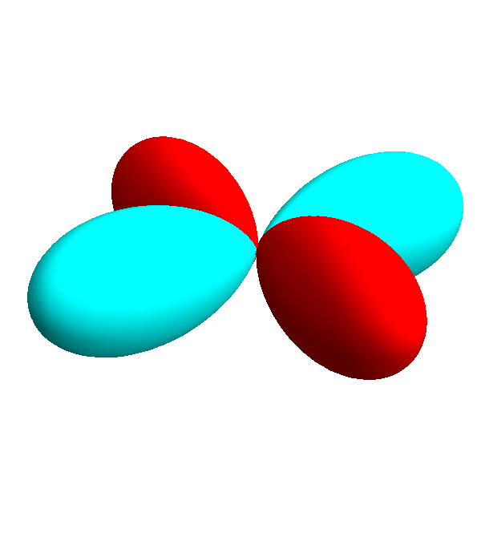
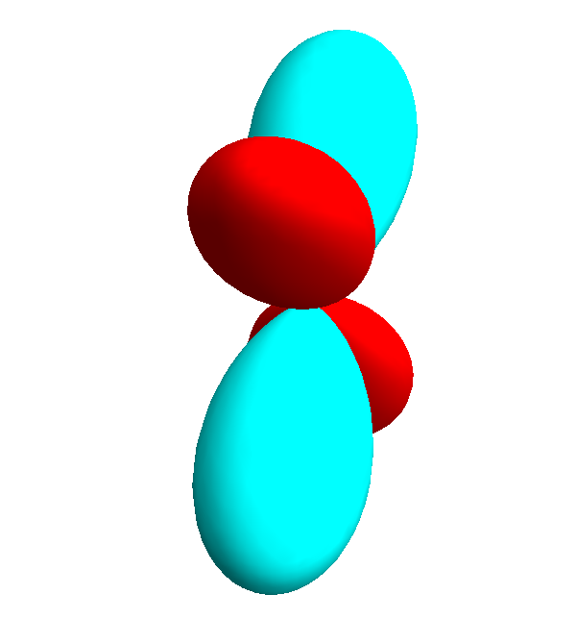
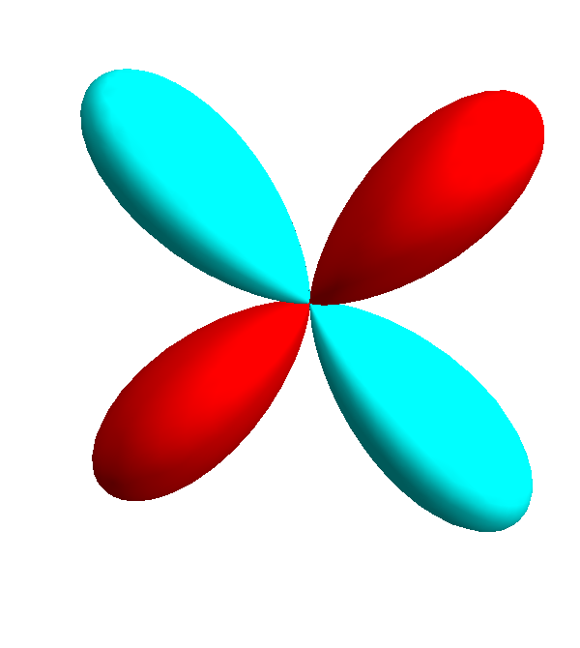
Quenching of orbital angular momentum – real orbitals

Slide 62
Quenching of orbital angular momentum – real orbitals
e_{g}
d
t_{2g}

Slide 63
Degenerate t_{2g} orbitals carry an effective orbital momentum
d
3-fold degenerate, like a p orbital

Slide 64
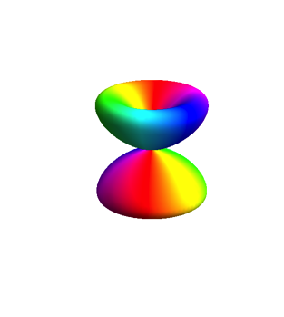
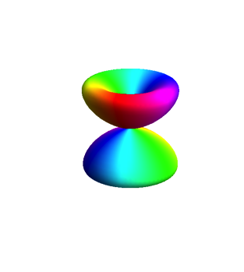
Degenerate xz – yz orbital
M.W. Haverkort et al. PRL, 101, 026406 (2008)

Slide 65
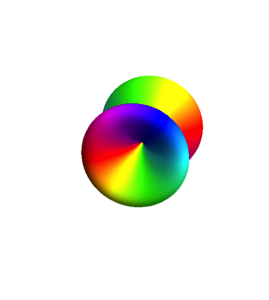
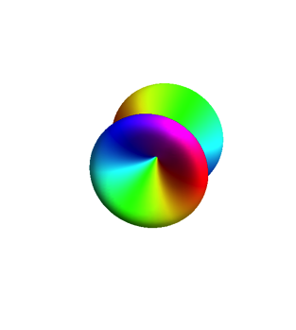
Degenerate xy – xz orbital
M.W. Haverkort et al. PRL, 101, 026406 (2008)

Slide 66
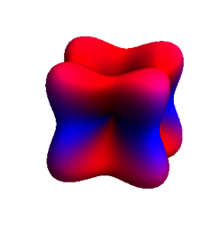
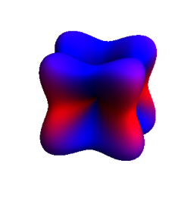
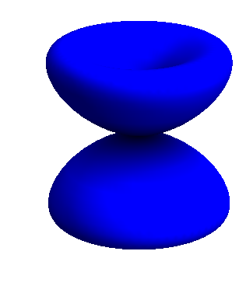
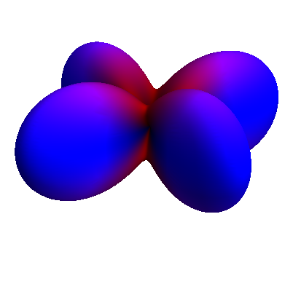
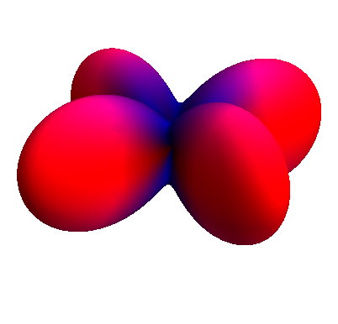
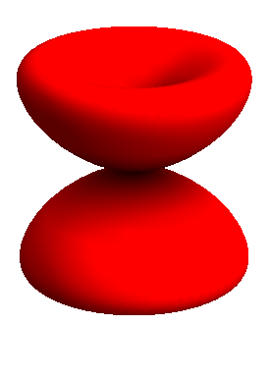
Degenerate t_{2g} orbitals
Doublet
Quartet

Slide 67
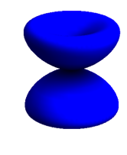
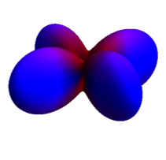
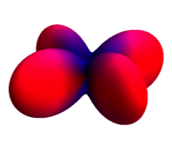
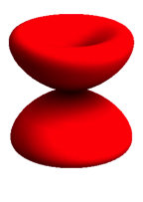
t_{2g} electron in a magnetic field
The quartet does not react to a magnetic field

Slide 68
t_{2g} electron in a magnetic field

Slide 69
t_{2g} electron in a magnetic field

Slide 70


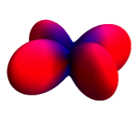
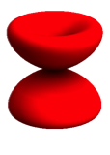


t_{2g} electron in a magnetic field

Slide 71
Degenerate t_{2g} orbitals
Doublet
Quartet

Slide 72
Effective moment of doublet and quartet – g-factor
Define:

Slide 73






Effective moment of doublet and quartet – g-factor
Define:

Slide 74
Effective moment of doublet and quartet – g-factor
Define:

Slide 75
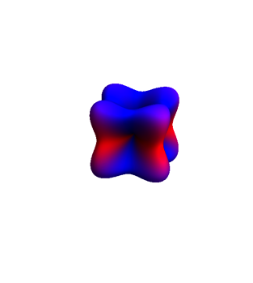
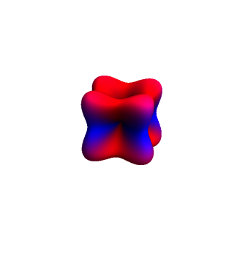
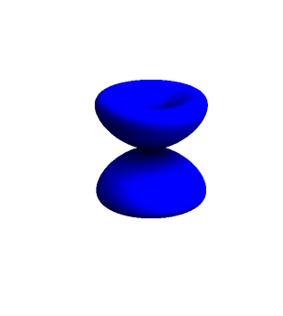
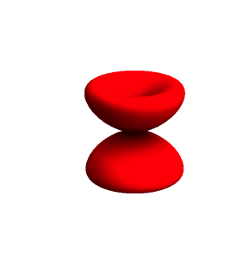

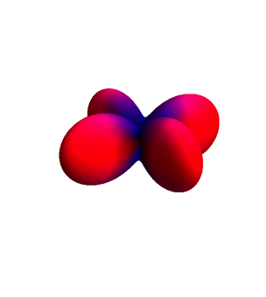
t_{2g} electron in crystal field of lower symmetry – quenching

Slide 76
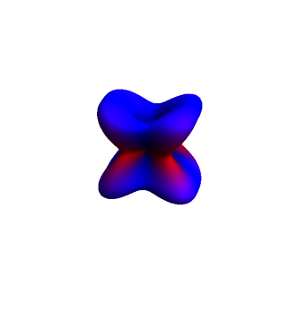
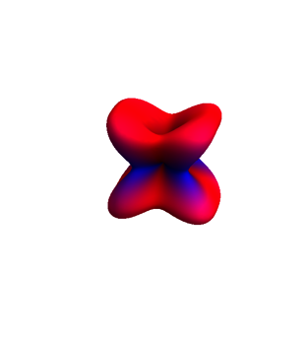
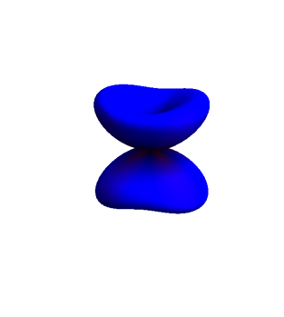
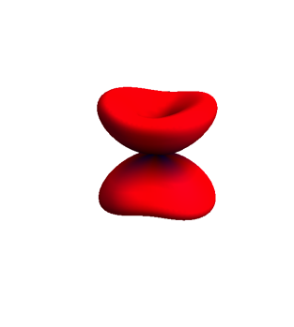
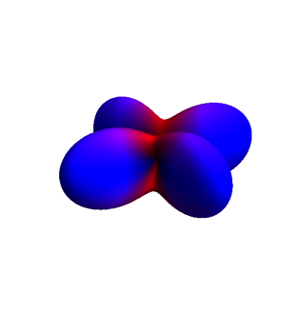

t_{2g} electron in crystal field of lower symmetry – quenching

Slide 77






t_{2g} electron in crystal field of lower symmetry – quenching

Slide 78






t_{2g} electron in crystal field of lower symmetry – quenching

Slide 79






t_{2g} electron in crystal field of lower symmetry – quenching

Slide 80
Kramers doublet
Systems with an odd number of electrons will at least have two fold degenerate states. (pseudo spin up and pseudo spin down).
An odd number of electrons means that the pseudo-spin is half integer valued and under time reversal spin inverts (up to down, down to up).

Slide 81

Tight-binding
From atoms to solids part (2)
Simple cubic lattice
Each site one s and one p orbitals

Slide 82




Tight-binding

Slide 83

Tight-binding

Slide 84
Tight-binding
p-orbital can hop to the same p-orbital

Slide 85
Tight-binding
p-orbital can hop to an s-orbital

Slide 86
Tight-binding
p to p hopping, same sign for left and right moves, Cos dependence
p to s hopping, different sign for left and right moves, i Sin dependence

Slide 87
Tight-binding
Bandstructure for
ssσ =-3
ppσ = 2
spσ = 0
s
Energy
p
Momentum in the crystal

Slide 88

Tight-binding
Bandstructure for
ssσ =-3
ppσ = 2
spσ = 2
s
Energy
p
Momentum in the crystal

Slide 89

Tight-binding
Bandstructure for
ssσ =-3
ppσ = 2
spσ = 2
Energy
Momentum in the crystal

Slide 90

Tight-binding - surface
Bandstructure for
ssσ =-3
ppσ = 2
spσ = 2
Energy
Rashba splitting due to surface
Momentum in the crystal

Slide 91
Rashba effect
How can an electron hop from site A to B
Surface layer

Slide 92
Rashba effect
How can an electron hop from site A to B
Surface layer

Slide 93
Rashba effect
Surface layer

Slide 94
Rashba effect
Surface layer

Slide 95
Rashba effect
Surface layer

Slide 96
Rashba effect
Surface layer

Slide 97
Rashba effect
Surface layer

Slide 98
Rashba effect
How can an electron hop from site A to B
Surface layer

Slide 99
Rashba effect
How can an electron hop from site A to B
Surface layer

Slide 100
Rashba effect
Surface layer

Slide 101
Rashba effect
Surface layer

Slide 102
Rashba effect
Surface layer

Slide 103
Rashba effect
Surface layer

Slide 104
Rashba effect
Surface layer

Slide 105
Rashba effect
Surface layer

Slide 106

Topology in tight-binding

Slide 107
…

